Slide 1
Data Quality Revolution The Fabric-OpenAI Approach
Nagaraj Sengodan, Alpa Buddhabhatti

Slide 2
Contents
NAGRAJ SENGODAN
01
Generative AI
02
Large Language Model (LLM)
03
Fabric & Open AI
Solution Architect
Specialized in data and AI Consulting, Strategy, Solution Architecture, and Implementation
04
Demo / Q & A
Notes:
Throughout the course of this deck, we will show you how organizations are already transforming productivity with AI experience, and how you can build powerful AI applications with Microsoft Fabric and Azure AI Studio.
What you’ll take away from this presentation is an understanding of:​
The impact of AI on the data analytics landscape
How Microsoft Fabric is the center of data gravity
How to integrate AI-Powered experiences with co-pilot in Microsoft Fabric
An introduction of Azure AI Studio and it’s AI capabilities for developers
How to Accelerate your ML journey with Microsoft Fabric and AML
Microsoft’s approach to sage and responsible AI
And next steps on how to begin your AI integration with Microsoft

Slide 3
Machine Learning
Deep Learning
Generative AI
Machine Learning
Machine learn from existing data and improve upon that data to make decisions or predictions
Deep Learning
A Machine Learning technique in which layers of neural networks are used to process data and make decisions
Generative AI
Create a new written, visual, and auditory content given prompts or existing data

Slide 4
Large Language Model
Labelled Data
ML Model Training
Classification
Unlabelled Data
(Many TBs)
Large Launguage Model Training
(£££)
Classification
Labelled Data
ML Model Training
Entity Extraction
Entity Extraction
Labelled Data
ML Model Training
Summarization
Summarization
One model per capability
Labelled data to train
Highly optimizes for use case
Single model for all use cases
Describe in natural language what it should do

Slide 5
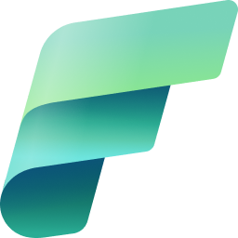


Drive AI innovation across digital landscapes with the combined power of Microsoft Fabric and Azure AI Studio
Microsoft Fabric
Azure AI Studio
Your unified solution for analytics
Your gateway to AI apps and custom copilot experiences
OneLake serves as the connective tissue to build generative AI apps powered by your data

Slide 6
Demo
Fix Data Issues

Slide 7

LLM based Data Validation
Dataset Input: The initial dataset, potentially sourced from an Enterprise Data Warehouse (EDW) database, is subjected to a validation step. Queries can be performed to extract specific data from the EDW database as input.
Validation: The dataset undergoes a validation process which checks for inconsistencies or errors. Post-validation, the dataset is bifurcated into two paths: "Fixed Dataset" and "Not Fixed Dataset".
Fixed Dataset: This path contains records that have been successfully validated and corrected. The fixed records can be fed back into the dataset for future use.
Not Fixed Dataset: Records that were not fixed through automatic validation are processed further. They are combined with a prompt and contextual information before being sent to the LLM API for processing.
LLM API: The Large Language Model API attempts to correct or enhance the records that were not automatically fixed by the validation step. The API utilizes the provided prompts and contextual data to generate a corrected output.
Validation and Review: The output from the LLM API is validated again. If the records are not fixed successfully, they are routed for manual review. If fixed, they are directed back into the "Fixed Dataset".
Review
Not Fixed
Dataset
Validation
Prompt + Context
LLM API
Query
Data
Fixed Dataset
Not Fixed Dataset
Validate
EDW Database

Slide 8
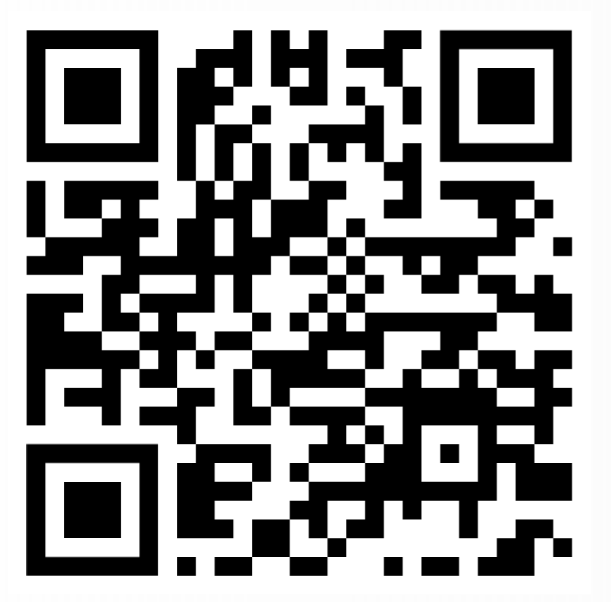
Q & A
Github

Slide 9



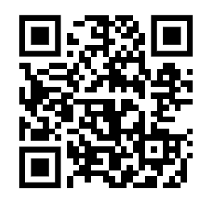
Thank you
Social Networks

